Slide 1
[CVSD] EPS Tutorial

Slide 2
Outline
EPS and congestion introduction
Why EPS
Congestion
How to solve congestion
Use EPS in FP to enhance APR result
Design compiler topographical mode tutorial

Slide 3
Why EPS (Early-stage Physical Synthesis)
Physical aware synthesis (synthesis with APR engine)
Trail placement and routing with specified floor plan
Bridge between front-end and back-end
Over congested design will be impossible for PD team to solve during APR stage
EPS can reduce the iteration number between front RTL designer and PD team
RTL designer should fix congestion issue during EPS either through RTL change or floor plan change

Slide 4
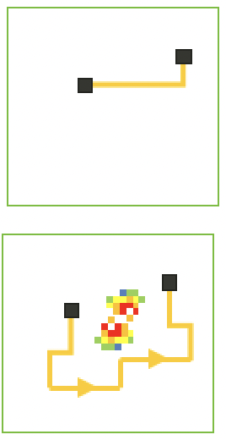
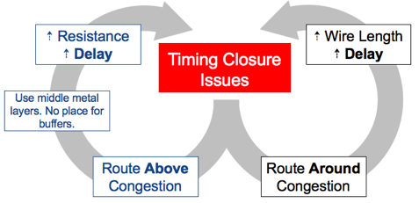
Congestion
Definition: Routing tracks resources insufficient in particular area
Causes:
High cell density, high pin density(worse in smaller process), bad floor plan could cause congested region
Harsh timing constraint worsen the congestion problem
Insert buffer
↑Cell area

Slide 5
How to Solve Congestion
Floor plan method:
Lowing Urate => ↑ area
Close to 1:1 aspect ratio => ↓ SoC floor plan flexibility (need to consider other subsys in the SoC)
Reasonable SRAM or macro placement => no overhead
Placement should follow data flow
RTL level method:
Aware to redundant logic (useless cells or routing)
e.g., MUL first than MUX (redundant MUX cells due to early bit-width expansion) vs MUX first than MUL
Reasonable pipelining => Ease timing closure issue
Infer_mux compiler directive => replace AOI/OAI MUX with MUX cell => Replace some of the over cell routing with in-cell routing

Slide 6
Use EPS in FP to Enhance APR Result
Setting a strict floor plan (high Urate) during EPS to spot congestion weak point in your design
Try to fix the congestion issue through RTL level method
APR result can achieve higher Urate without DRC/LVS errors which were caused by routing tracks resources insufficient.
Congestion free design

Slide 7
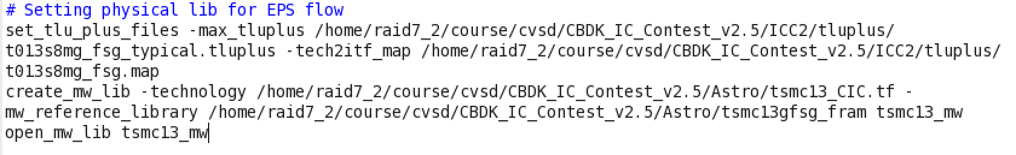



Design Compiler Topographical Mode
Open topo mode for EPS synthesis
Load physical lib
Set physical constraint before synthesis (setting a strict constraint to spot congestion weak point)
Note that only compile_ultra is available for topo mode synthesis

Slide 8
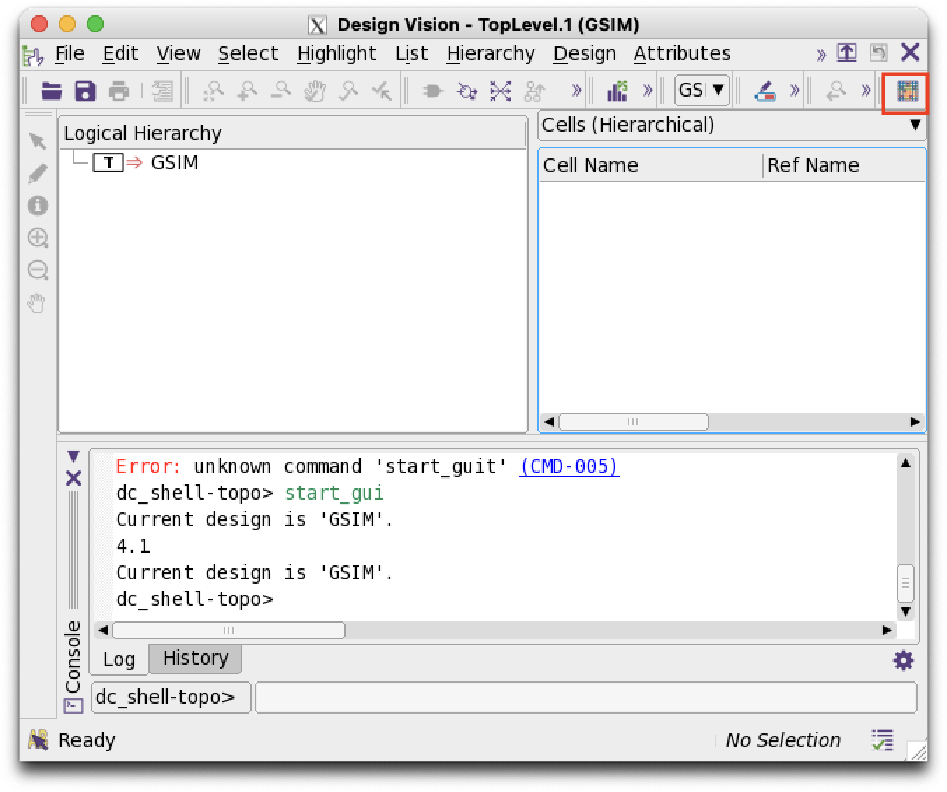

Using GUI to Find out RTL Congestion Bugs (1)
Start gui for RTL congestion debug
Start floorplan viewer

Slide 9
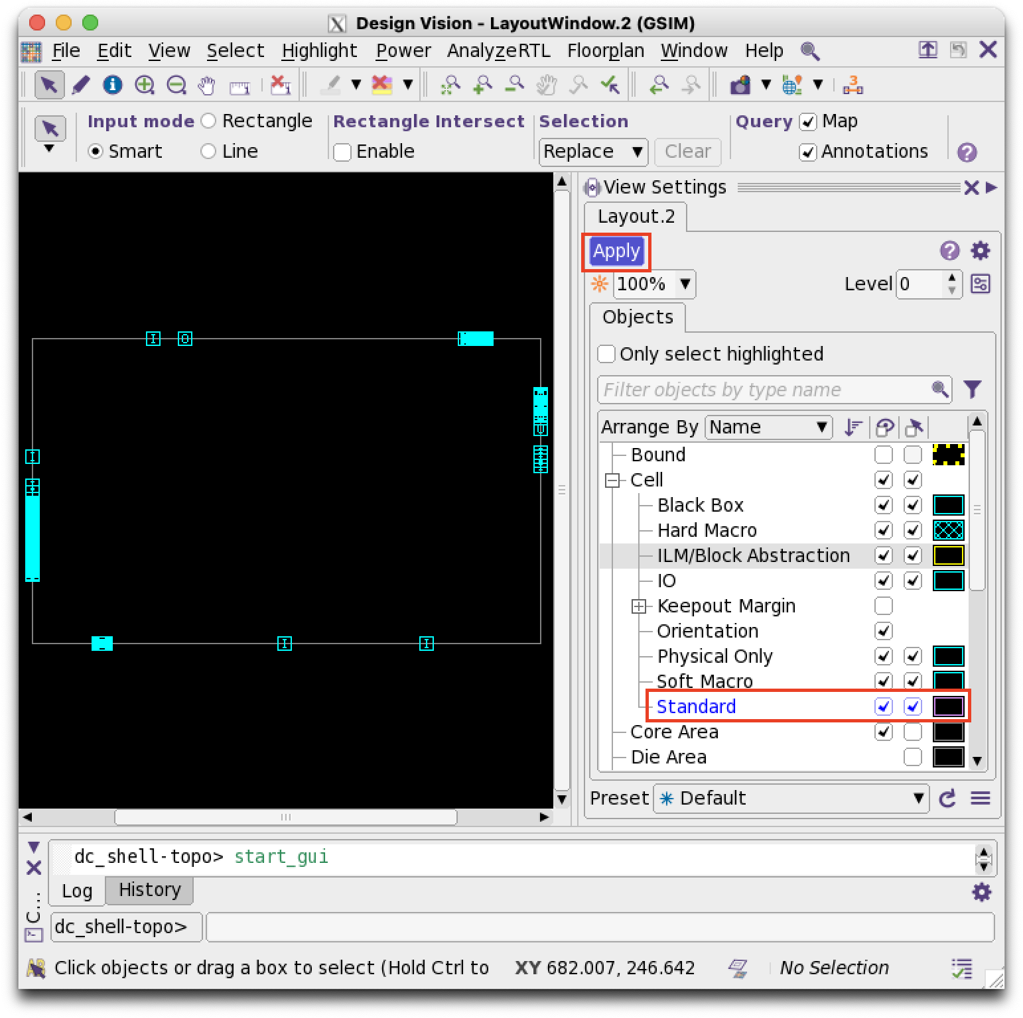
Using GUI to Find out RTL Congestion Bugs (2)
Enable standard cell visibility

Slide 10
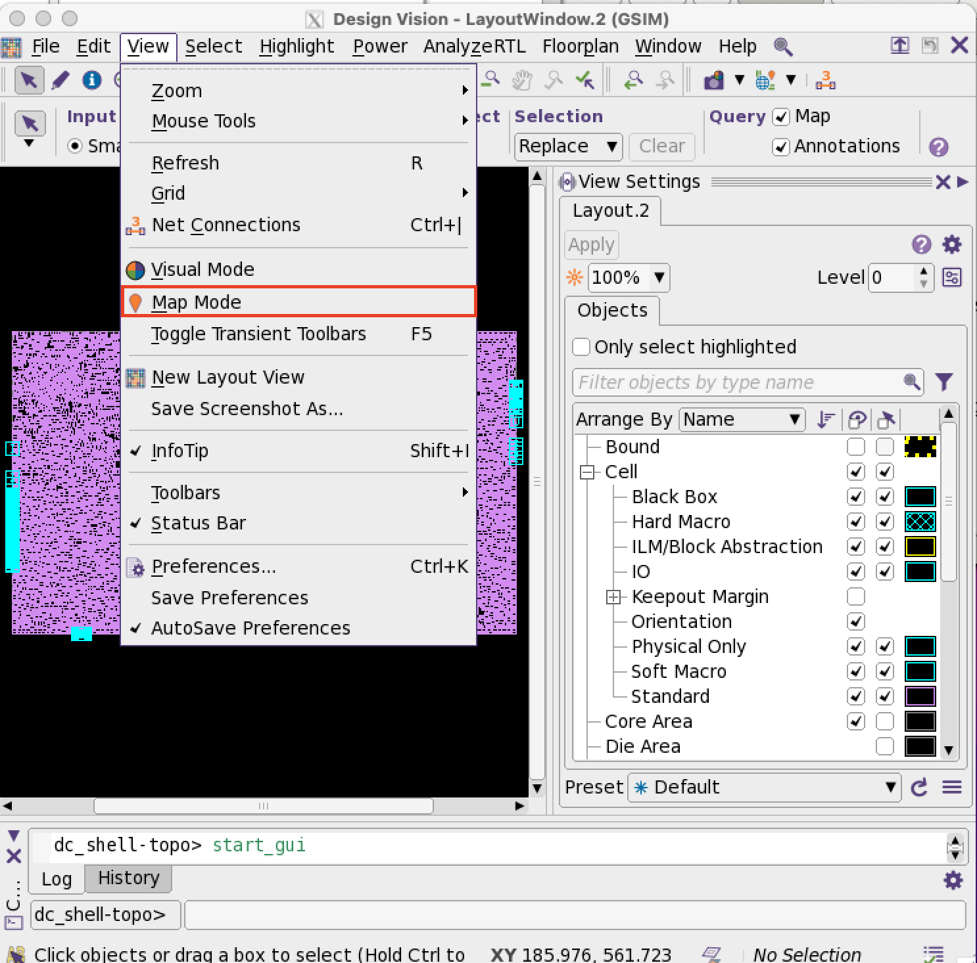
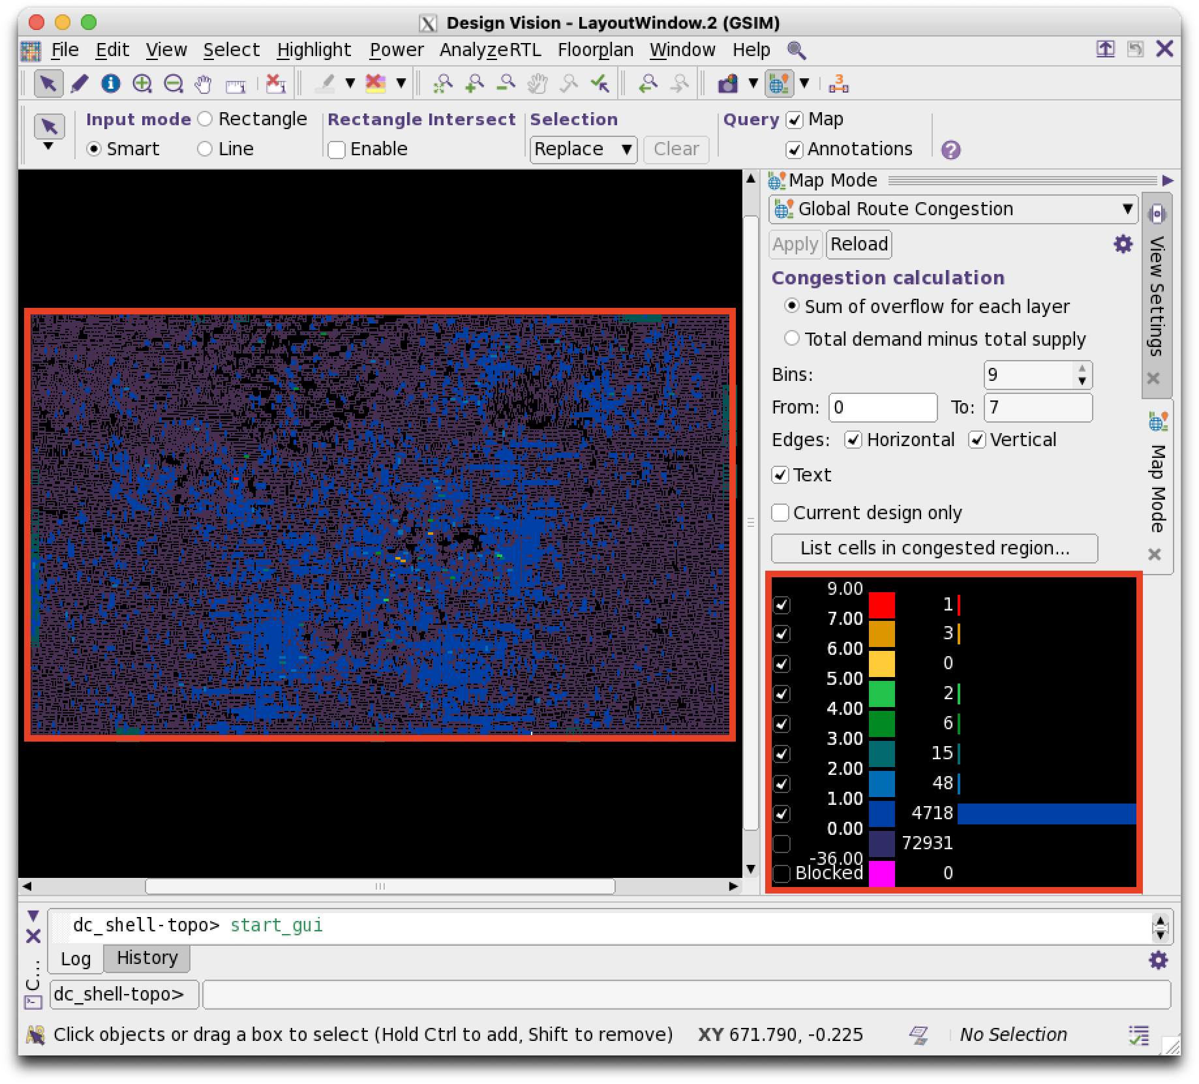
Using GUI to Find out RTL Congestion Bugs (3)
Congestion map
Congestion distrebution
Hot spot

Slide 11
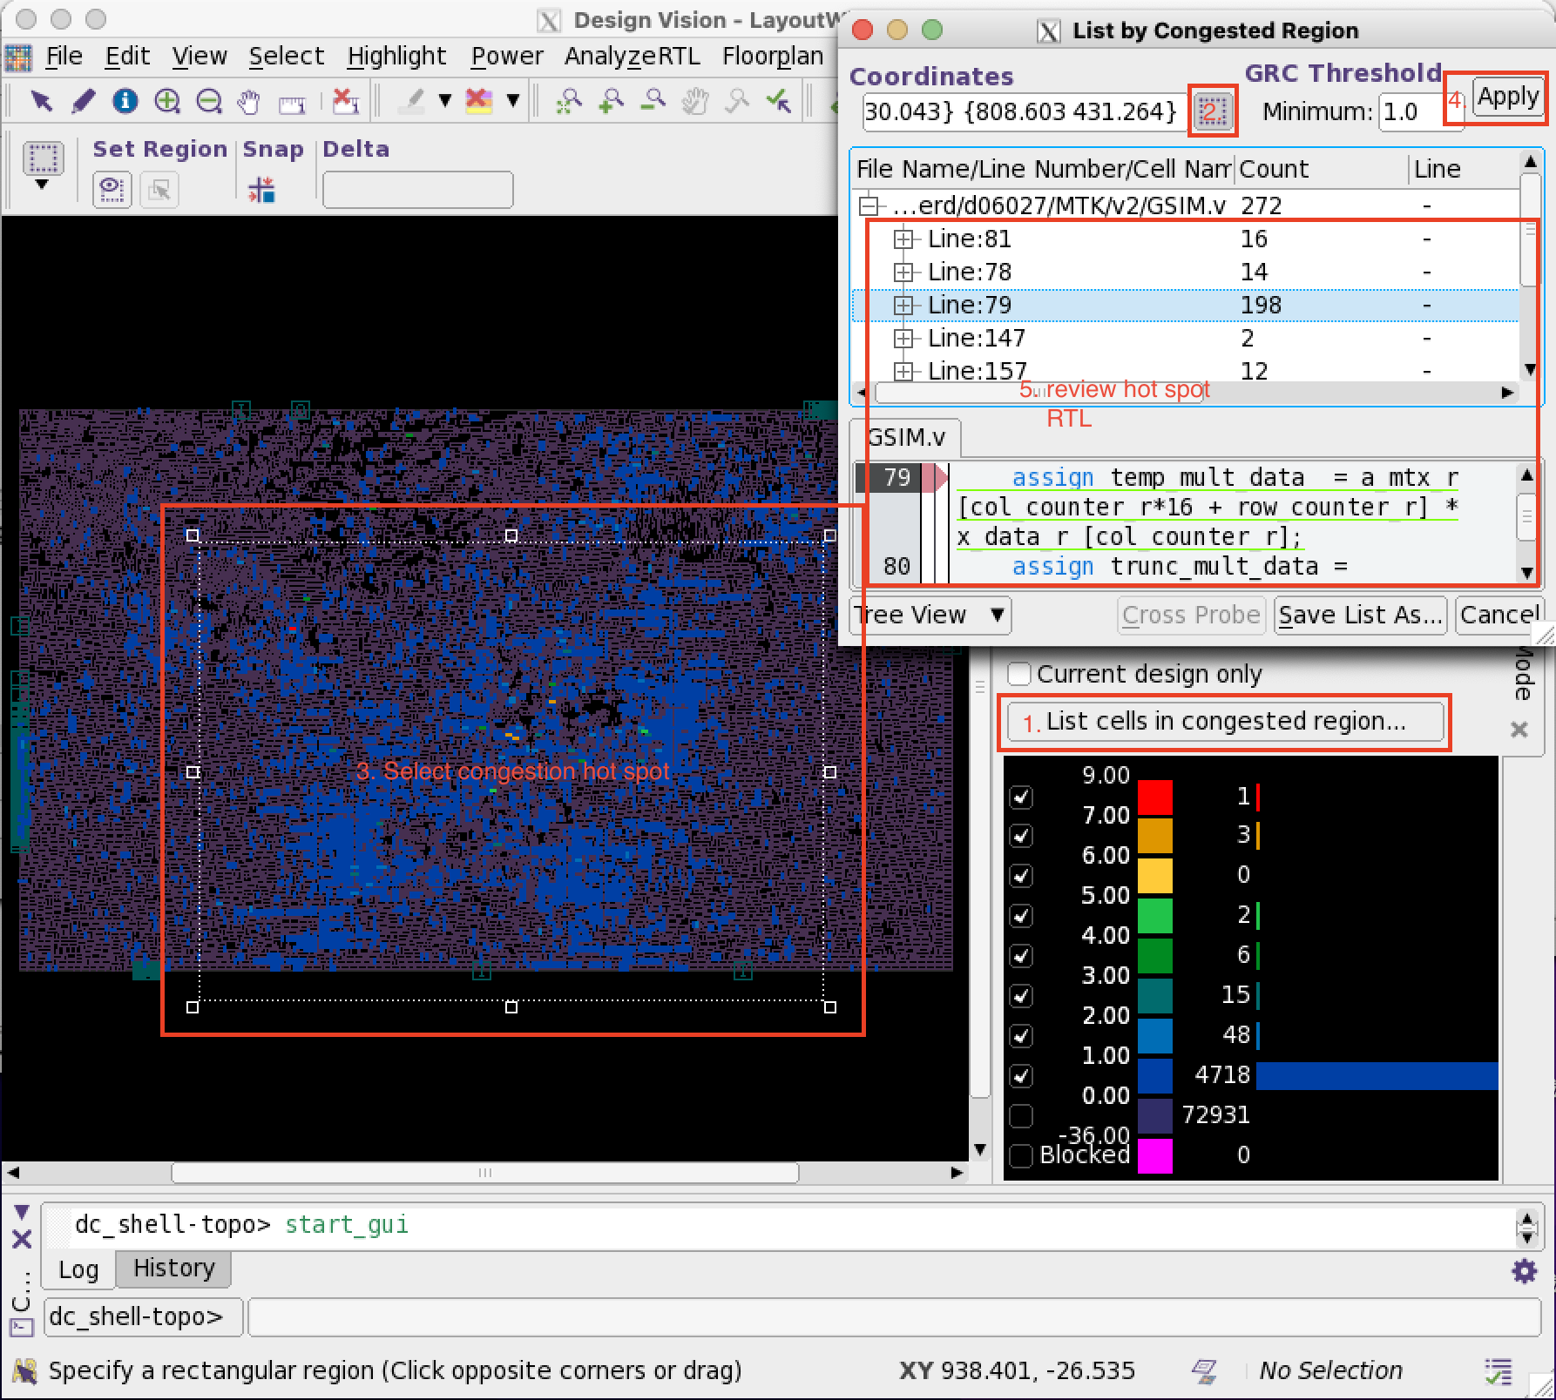
Using GUI to Find out RTL Congestion Bugs (4)
Review RTL for hot spot
Try to:
Remove redundant logic
Reorder combinational
Adding pipeline on congested critical path

